Slide 1
Trigonometry
The study of angles

Slide 2
Reference Angle:
P.3.1
The reference angle for any angle θ in standard position is the positive acute angle between the terminal side of θ and the x-axis. Often denoted as $\hat{\text{θ}}$.
y-axis
$θ$ = 240˚
$θ$ = 135˚
$\hat{\text{θ}}$ = 60˚
$\hat{\text{θ}}$ = 45˚
$θ$ = 330˚
$θ$ = 60˚
x-axis
$\hat{\text{θ}}$ = 60˚
$\hat{\text{θ}}$ = 30˚

Slide 3
Reference Angle Rules (for angles between 0˚ and 360˚):
P.3.1
y-axis
If θ is in QI, then $\hat{\text{θ}}$ = θ
If θ is in QII, then $\hat{\text{θ}}$ = 180˚ - θ
If θ is in QIII, then $\hat{\text{θ}}$ = θ - 180˚
If θ is in QIV, then $\hat{\text{θ}}$ = 360˚ - θ
x-axis
Reference Angle Rules: bigger than 360˚?
Just subtract 360˚ (you’ll be finding a coterminal angle)

Slide 4
Reference Angle Theorem: A trig function of an angle and its reference angle differ at most in sign (depending on the quadrant it terminates in).
P.3.1

Slide 5
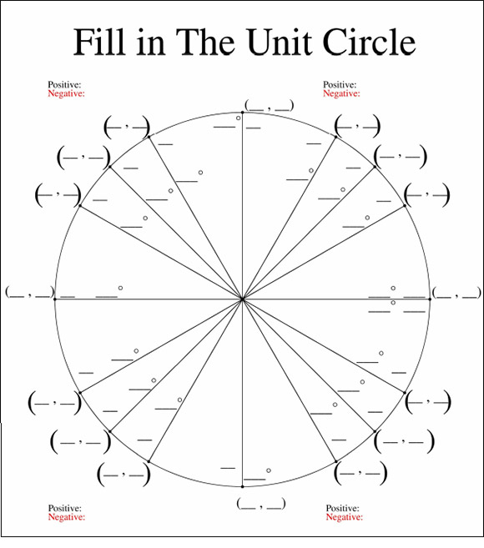
P.3.1
Reference Angle:
Helps us figure out any trig function value anywhere.

Slide 6
Radians and Degrees:
P.3.2
Much like the metric system and standard system of measurements. They measure the same thing but differently. One makes sense and the other doesn’t.
What is the definition of a degree?
What is the definition of a Radian?

Slide 7
What is the definition of a Radian?
P.3.2
θ = $1 radian$
r
s
θ = $\frac{\text{r}}{\text{r}}$
θ
θ
r
r
θ = $\frac{\text{S}}{\text{r}}$
must be in radians
A central angle that cuts off an arc equal in length to the radius of the circle.

Slide 8
Arc Length
P.3.2
θ = $\frac{\text{S}}{\text{r}}$
s = θr
s
must be in radians
θ
r
How many radian’s are in one complete rotation?
θ = 2$π$
s =2$π$r

Slide 9
Angle Measure Conversion
P.3.2
θ = 360˚
$π$ = 180˚
θ = 2$π$
$\frac{π}{π}$ = $\frac{\text{1}\text{8}\text{0˚}}{π}$
$\frac{π}{\text{180˚}}$ = $\frac{\text{1}\text{8}\text{0˚}}{\text{180˚}}$
r
2$π$ = 360˚
$π$ = 180˚
1 = $\frac{\text{1}\text{8}\text{0˚}}{π}$
$\frac{π}{\text{180˚}}$ = 1˚
$\frac{π}{2}$ = 90˚
$\frac{π}{4}$ = 45˚
Conversion factors!
$\frac{π}{3}$ = 60˚
$\frac{π}{6}$ = 30˚

Slide 10
Angle Measure Conversion
P.3.2
B$\left(\frac{π}{\text{180˚}}\right)$
Degrees
Radians
B$\left(\frac{\text{180˚}}{π}\right)$

Slide 11
The Six Trigonometric Functions III
P.3.3
csct = $\frac{\text{1}}{\text{y}}$
(x , y)
sint = y
t
sect = $\frac{\text{1}}{\text{x}}$
(1 , 0)
cost = x
tant = $\frac{\text{y}}{\text{x}}$
cott = $\frac{\text{x}}{\text{y}}$

Slide 12
P.3.3
 | 0˚, 0 | 30˚, $\frac{π }{\text{6} }$ | 45˚, $\frac{π }{\text{4} }$ | 60˚, $\frac{π }{\text{3} }$ | 90˚, $\frac{π }{\text{2} }$
sinA | 0 | $$\frac{\text{1 }}{\text{2 }}$$ | $$\frac{\text{1 }}{\sqrt{\text{2 }}}$$ | $$\frac{\sqrt{\text{3 }}}{\text{2 }}$$ | 1
cosA | 1 | $$\frac{\sqrt{\text{3 }}}{\text{2 }}$$ | $$\frac{\text{1 }}{\sqrt{\text{2 }}}$$ | $$\frac{\text{1 }}{\text{2 }}$$ | 0
tanA | 0 | $$\frac{\text{1 }}{\sqrt{\text{3 }}}$$ | 1 | $$\sqrt{\text{3 }}$$ | Undefined

Slide 13
For $θ$ in… | QI | QII | QIII | QIV
sin$θ$ and csc$θ$ | + | + | - | -
cos$θ$ and sec$θ$ | + | - | - | +
tan$θ$ and cot$θ$ | + | - | + | -
P.3.3

Slide 14
P.3.3

Slide 15
Even and Odd Functions
P.3.3
Even Functions: $f\left(−x\right)=f(x)$
Even: when opposite values are used for the input, the output values will be equivalent
Odd Functions: $f\left(−x\right)=−f(x)$
Odd: when opposite values are used for the input, the output values will be opposite values

