Slide 1
Trigonometry
The study of...
Angles.

Slide 2







Standard Position
P.1.1
y-axis
Terminal Side
Quadrant II
Quadrant I
(Theta)
+$θ$ is rotated counter-clockwise
$$θ$$
“Angle $θ$
Terminates in QII”
$$θ$$
Initial Side
x-axis
-$θ$
Quadrant IV
Complementary Angles:
2 angles that add to 90˚
Quadrant III
-$θ$ is rotated clockwise
“Angle $θ$
Terminates in QIII”
Supplementary Angles:
2 angles that add to 180˚
Coterminal Angles:
2 angles in standard position with the same terminal side

Slide 3
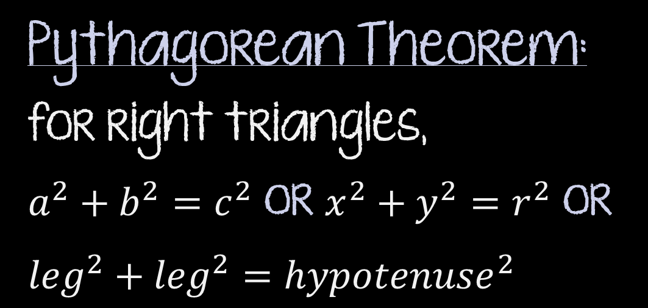

y-axis
Pythagorean Theorem: for right triangles,
$a^{2}+b^{2}=c^{2}$ or $x^{2}+y^{2}=r^{2}$ or ${leg}^{2}+{leg}^{2}={hypotenuse}^{2}$
P.1.1
r
y
$$θ$$
x-axis
x
Triangle Angle Sum Theorem:
All angles in a triangle add to 180˚
Special Right Triangles
30˚-60˚-90˚
45˚-45˚-90˚

Slide 4
P.1.1
45˚-45˚-90˚
t² + t² = Hypotenuse²
45˚
t 2
2t² = Hypotenuse²
t
t 2= Hypotenuse
45˚
1, 1, 2
t
Isosceles Triangle

Slide 5
P.1.1
30˚-60˚-90˚
60˚
t² + (h)² = (2t)²
30˚
30˚
2t
t² + (h)² = 4t²
30˚
2t
(h)² = 3t²
t 3
60˚
h = t 3
60˚
60˚
t
t
t
2t
1, 2, 3
Equilateral Triangle

Slide 6
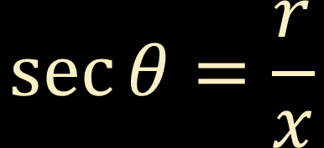
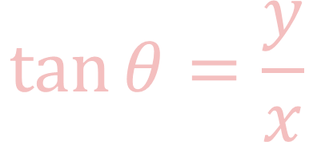

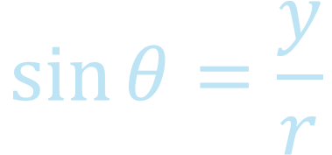

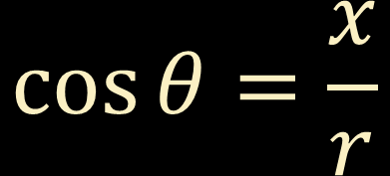
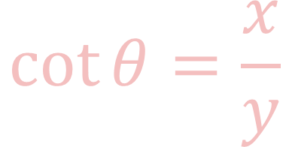
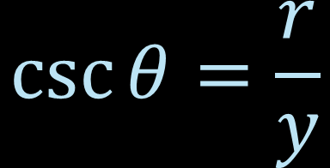
The Six Trigonometric Functions I
P.1.3
y-axis
$$\sin{θ=\frac{y}{r}}$$
$$\csc{θ}=\frac{r}{y}$$
(x, y)
$$\cos{θ=\frac{x}{r}}$$
$$\sec{θ=\frac{r}{x}}$$
r
QII
y
QI
$$\tan{θ=\frac{y}{x}}$$
$$\cot{θ=\frac{x}{y}}$$
(-, +)
$$θ$$
(+, +)
x-axis
x
QIII
Think Alphabetical
QIV
(-, -)
$$r=\sqrt{x^{2}+y^{2}}$$
(+, -)
(x, y) = (cosA, sinA)

Slide 7
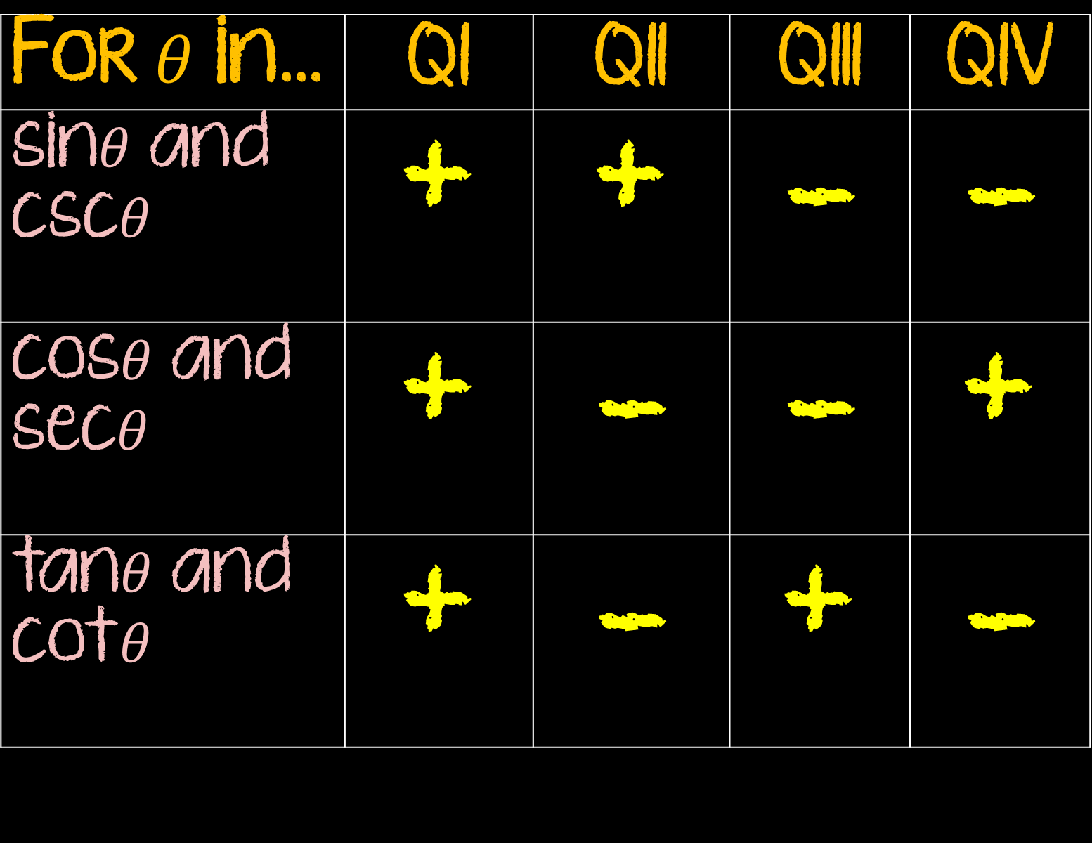
For $θ$ in… | QI | QII | QIII | QIV
sin$θ$ and csc$θ$ | + | + | - | -
cos$θ$ and sec$θ$ | + | - | - | +
tan$θ$ and cot$θ$ | + | - | + | -
P.1.3

Slide 8
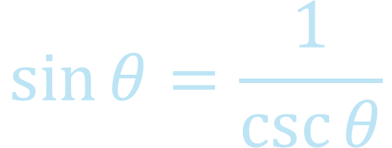


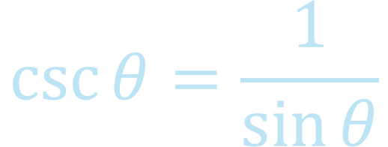


Trigonometric Identities
P.1.4
The Reciprocal Identities
$$\sin{θ=\frac{1}{\csc{θ}}}$$
$$\csc{θ}=\frac{1}{\sin{θ}}$$
$$\cos{θ=\frac{1}{\sec{θ}}}$$
$$\sec{θ=\frac{1}{\cos{θ}}}$$
Memorize
$$\tan{θ=\frac{1}{\cot{θ}}}$$
$$\cot{θ=\frac{1}{\tan{θ}}}$$

Slide 9
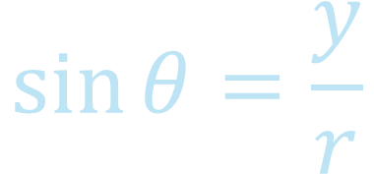
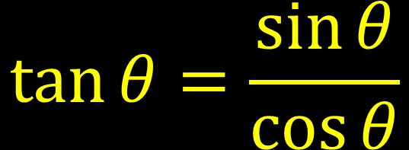
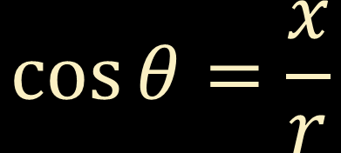
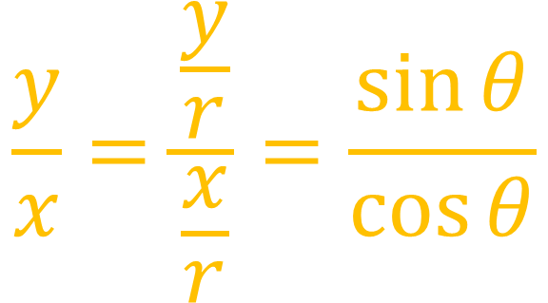

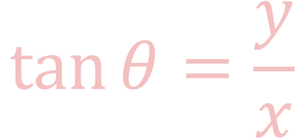
Trigonometric Identities
P.1.4
The Ratio Identities
$$\sin{θ=\frac{y}{r}}$$
$$\frac{y}{x}=\frac{\frac{y}{r}}{\frac{x}{r}}=\frac{\sin{θ}}{\cos{θ}}$$
$$\cos{θ=\frac{x}{r}}$$
Memorize
$$\tan{θ=\frac{y}{x}}$$
$$\tan{θ=\frac{\sin{θ}}{\cos{θ}}}$$
$$\cot{θ=\frac{\cos{θ}}{\sin{θ}}}$$

Slide 10
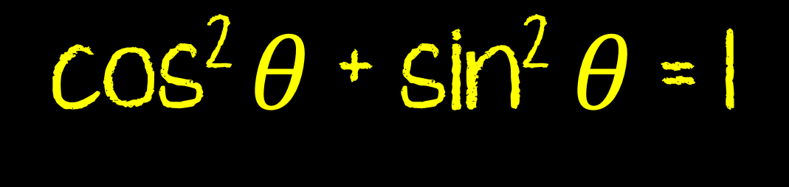



Trigonometric Identities
y-axis
P.1.4
r
y
The Pythagorean Identities
$$θ$$
x-axis
(sin$θ$)² = sin² $θ$
x
First
R = 1
Okay, now…
x² + y² = r²
cos² $θ$ + sin² $θ$ = 1
(x, y) = (cos$θ$, sin$θ$)
Memorize

Slide 11
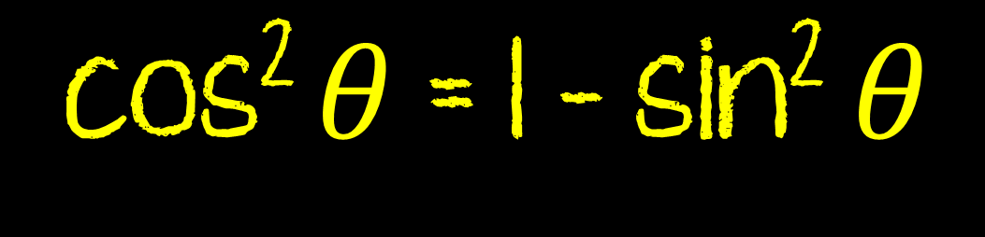


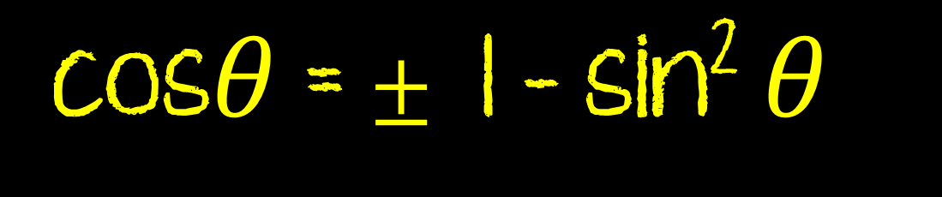
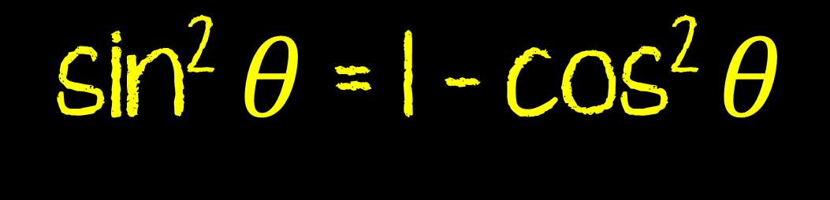
The Pythagorean Identities (alternate forms)
P.1.4
cos² $θ$ + sin² $θ$ = 1
Memorize
cos² $θ$ = 1 - sin² $θ$
sin² $θ$ = 1 - cos² $θ$
cos$θ$ = $±$ 1 - sin² $θ$
sin$θ$ = $±$ 1 - cos² $θ$

Slide 12

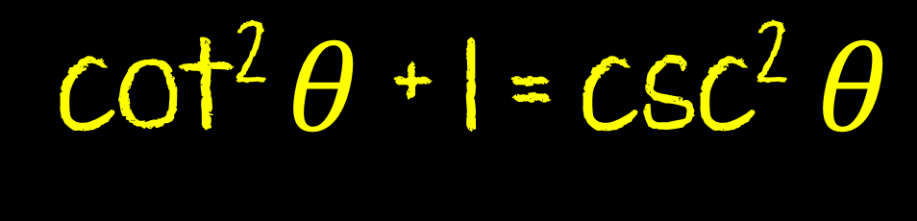
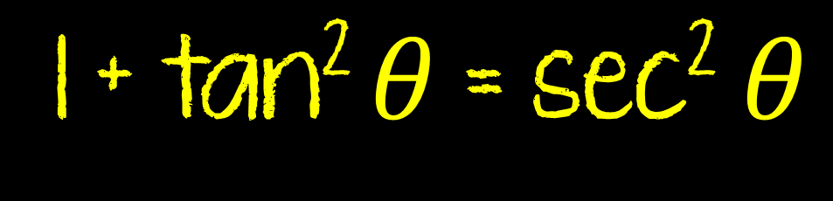
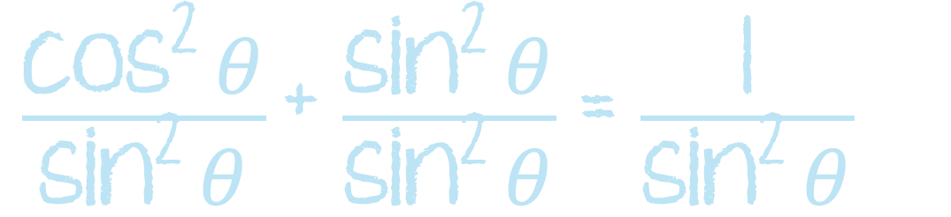
The Pythagorean Identities (alternate forms)
P.1.4
cos² $θ$ + sin² $θ$ = 1
Memorize
$\frac{\text{cos}\text{2} θ}{\text{cos}\text{2} θ}$ + $\frac{\text{s}\text{in}\text{2} θ}{\text{cos}\text{2} θ}$ = $\frac{\text{1}}{\text{cos}\text{2} θ}$
$\frac{\text{cos}\text{2} θ}{\text{s}\text{in}\text{2} θ}$ + $\frac{\text{sin}\text{2} θ}{\text{sin}\text{2} θ}$ = $\frac{\text{1}}{\text{sin}\text{2} θ}$
1 + tan² $θ$ = sec² $θ$
cot² $θ$ + 1 = csc² $θ$

Slide 13
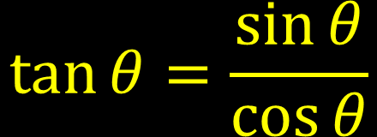
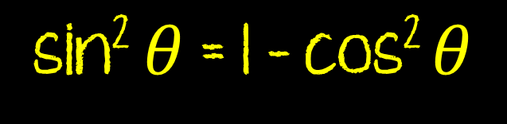
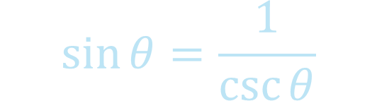
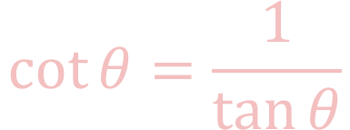
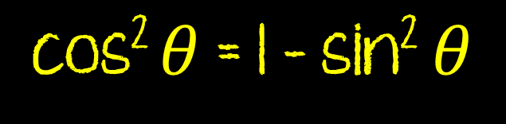
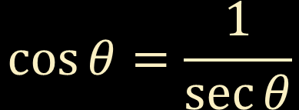

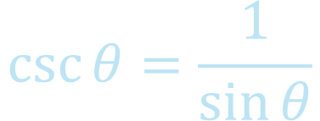
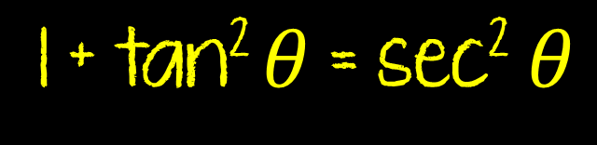
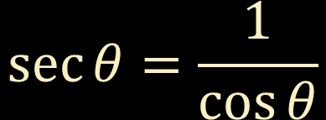

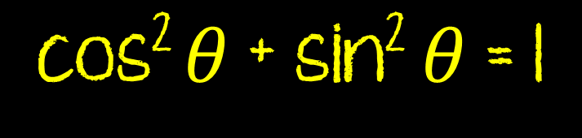

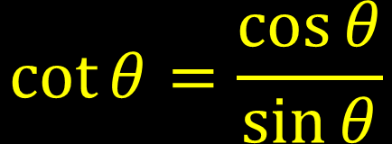
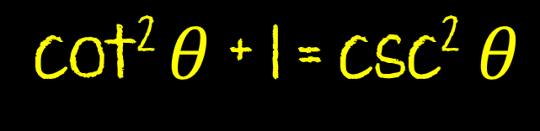
The Reciprocal Identities
P.1.4/P.1.5
$$\sin{θ=\frac{1}{\csc{θ}}}$$
$$\csc{θ}=\frac{1}{\sin{θ}}$$
The Ratio Identities
$$\cos{θ=\frac{1}{\sec{θ}}}$$
$$\sec{θ=\frac{1}{\cos{θ}}}$$
$$\tan{θ=\frac{\sin{θ}}{\cos{θ}}}$$
$$\cot{θ=\frac{\cos{θ}}{\sin{θ}}}$$
$$\tan{θ=\frac{1}{\cot{θ}}}$$
$$\cot{θ=\frac{1}{\tan{θ}}}$$
The Pythagorean Identities
cos² $θ$ + sin² $θ$ = 1
cos$θ$ = $±$ 1 - sin² $θ$
sin$θ$ = $±$ 1 - cos² $θ$
cos² $θ$ = 1 - sin² $θ$
sin² $θ$ = 1 - cos² $θ$
1 + tan² $θ$ = sec² $θ$
cot² $θ$ + 1 = csc² $θ$

Slide 14
Algebra Things to Keep in Mind
Expand It! Factor (The difference of squares)
Condense It! Distribute (The difference of squares)
Multiply by ONE (The difference of squares/conjugate)
Simplify complex fractions (multiply by the reciprocal)
Common Denominator (to add fractions together)
Change everything to sines and cosines
Use the basic identities
P.1.5

Slide 15
P.1.5
Expression = Expression
Look at options for rewriting expression, pick one
Rewrite
Look and see options pick one
Rewrite
Look and see options pick one
Rewrite
Look and see options pick one
Rewrite

Slide 16
The Six Trigonometric Functions II
P.2.1
B
sinA =
cscA =
Hypotenuse
(c)
cosA =
secA =
Opposite
(a)
tanA =
cotA =
A
C
Adjacent
(b)

Slide 17
P.2.1
Co-Functions
Co-Function Theorem
A trig function of an angle is = to the cofunction of the complement
B
=90˚-A
(c)
(a)
sinA = cosB
secA = cscB
cosA = sinB
cscA = secB
A
C
(b)
tanA = cotB
cotA = tanB

Slide 18
The Six Trigonometric Functions II
P.2.1
Back to the 30˚-60˚-90˚
sin30˚ =
sin60˚ =
30˚
cos30˚ =
cos60˚ =
2x
X 3
tan30˚ =
tan60˚ =
60˚
x

Slide 19
The Six Trigonometric Functions II
P.2.1
Back to the 45˚-45˚-90˚
sin45˚ =
x 2
45˚
cos45˚ =
X
tan45˚ =
45˚
x
sin0˚ =
sin90˚ =
cos0˚ =
cos90˚ =
tan0˚ =
tan90˚ =

Slide 20
P.2.1
 | 0˚ | 30˚ | 45˚ | 60˚ | 90˚
sinA
cosA
tanA

Slide 21

Solving Right Triangles
P.2.3
Find ALL missing side lengths
Find ALL missing angle measures
Sides
Angles
- Pythagorean Theorem
- Triangle Angle Sum Theorem
- Trig
- Inverse Trig
SOH CAH TOA
SOH CAH TOA
TRIG(Angle)=$\frac{The ratio of the side lengths}{of a right triangle }$
TRIG(Angle)=TROTSLOART

Slide 22
Angle of Elevation and Depression
P.2.4
An angle measured from the horizontal rotated up is called an angle of elevation, rotated down is called an angle of depression.

