Slide 1
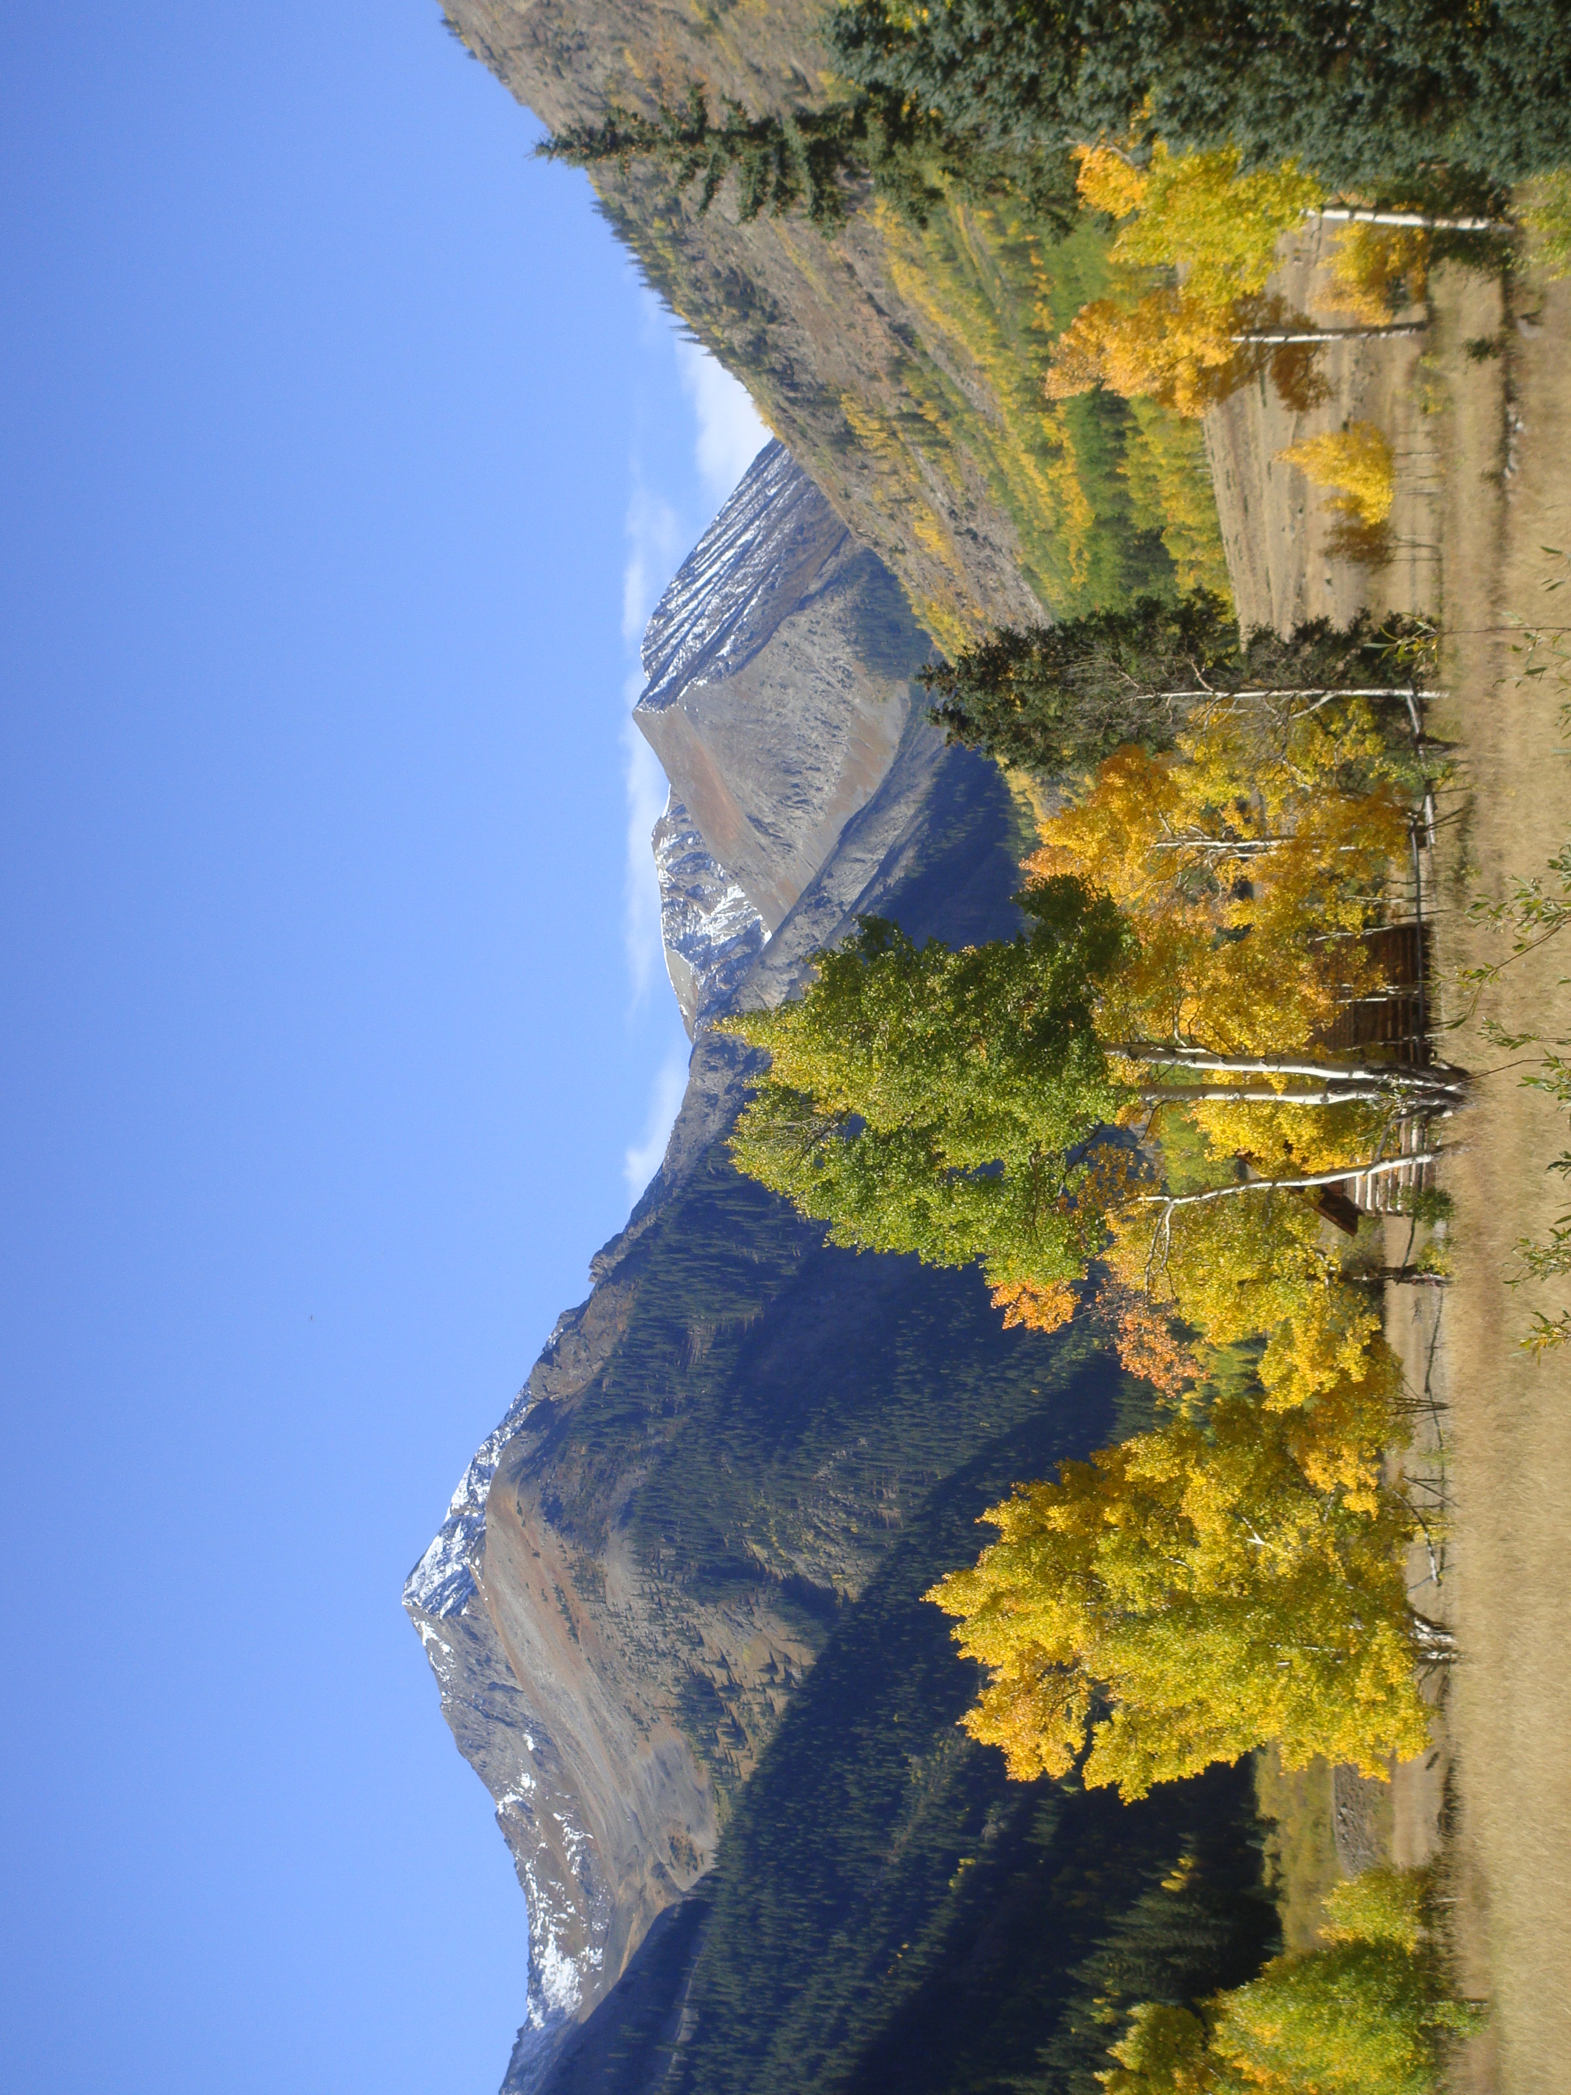
Describing Graphs

Slide 2
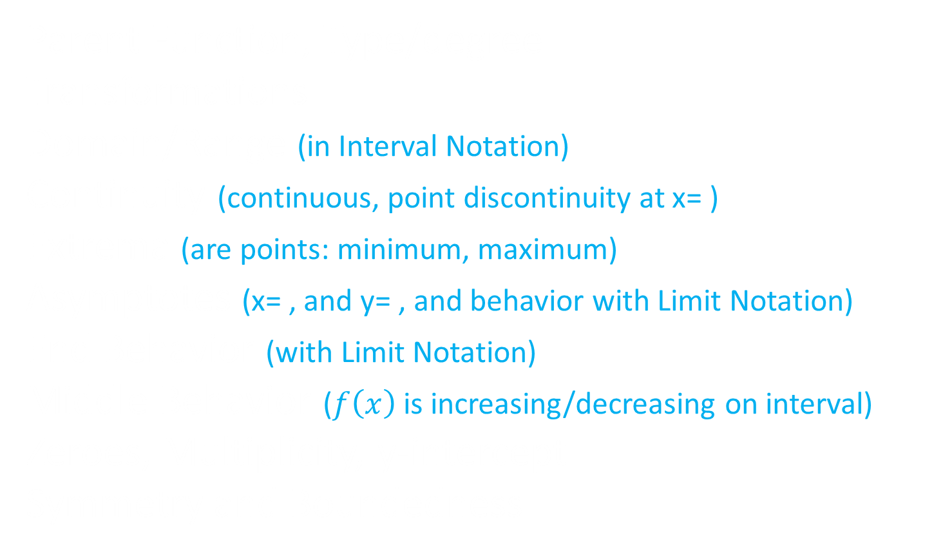
Top 10 Things to Describe a Graph
Parent Function, Type/degree
Transformations
Domain/Range (in Interval Notation)
Continuity (continuous, point discontinuity at x= )
Extrema (are points: minimum, maximum)
Asymptotes (x= , and y= , and behavior with Limit Notation)
End Behavior (with Limit Notation)
Middle Behavior ($f\left(x\right)$ is increasing/decreasing on interval)
Zeroes, Multiplicity, y-intercept
Symmetry and Boundedness

Slide 3
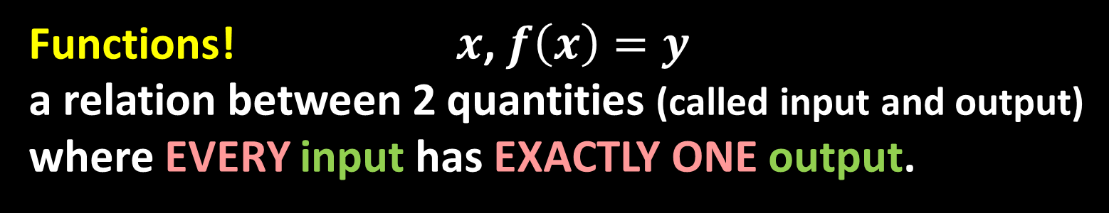





Functions! $x$, $f\left(x\right)=y$ a relation between 2 quantities (called input and output) where EVERY input has EXACTLY ONE output.
Domain: the set of ALL possible INPUT values (described in Interval Notation)
There are only 2 things that will restrict our domain!
$$\frac{1}{0}$$
Steps to find domain
1. Picture the graph
2. Assume the domain is all real numbers $\left(−∞,∞\right)$
3. Find restrictions from and in order of
the two no-no’s
4. If there is a square root, set the radicand $≥$ 0
5. If there is a variable in the denominator, set the
denominator = 0
$$\sqrt{−1}$$
$$\frac{1}{0}$$
$$\sqrt{−1}$$
Examples…

Slide 4

Range: the set of ALL possible OUTPUT values (described in Interval Notation)
Steps to find range
1. Picture the graph
2. Assume the range is all real numbers $\left(−∞,∞\right)$
3. Find restrictions, look to the parent function,
look at domain, consider specific expressions
output values, graph the function
Examples…

Slide 5



Continuity: smooth pattern in the y’s as x moves from $\left(−∞,∞\right)$. No breaks in the domain.
$$f\left(x\right)$$
Discontinuity: breaks in the smooth pattern in the y’s as x moves from $\left(−∞,∞\right)$

Slide 6






Point Discontinuity at x = $a$, even though
there is a y value
y
$$\left(a, f\left(a\right)\right)$$
$$f\left(a\right)$$
$$f\left(x\right)$$
$$a$$
x
Point Discontinuity at x = $a$, no y value
Point Discontinuity, Removable Discontinuity Fillable Discontinuity

Slide 7




Jump Discontinuity (non removable)
y
$$\left(a, f\left(a\right)\right)$$
$$f\left(x\right)$$
$$f\left(a\right)$$
$$a$$
x
Break Point

Slide 8



y
$$a$$
x
$$f\left(x\right)$$
Infinite Discontinuity
Vertical Asymptote!
At x = $a$

Slide 9





y
Discontinuity will be described with limit notation
$$\left(a, f\left(a\right)\right)$$
$$f\left(a\right)$$
$$f\left(x\right)$$
x
$$a$$
$$\lim_{x→a}\left(f\left(x\right)\right)=f\left(a\right)$$
Examples…

Slide 10
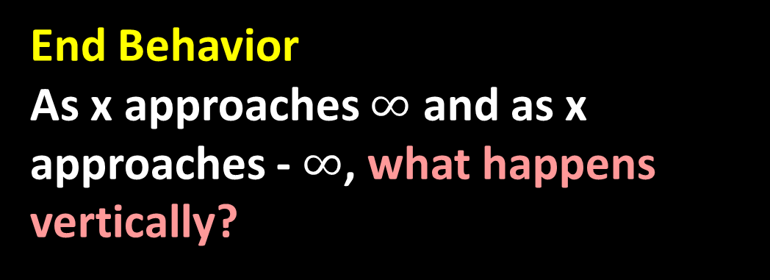

Middle Behavior (Increasing/Decreasing Behavior)
Describe the pattern of the y (increasing/decreasing) defined by the intervals of x (from left to right)
$f\left(x\right)$ increases on the interval ( , )
$f\left(x\right)$ decreases on the interval ( , )
End Behavior
As x approaches $∞$ and as x approaches - $∞$, what happens vertically?

Slide 11



y
$f\left(x\right)$ decreases on the interval ( , )
U ( , )
$$f\left(x\right)$$
x
-5
-1
4
$f\left(x\right)$ increases on the interval ( , )
U ( , )
Examples…

Slide 12
Extrema (For now, maximums and minimums)
Maximum a point where the functions behavior changes from increasing to decreasing.
Minimum a point where the functions behavior changes from decreasing to increasing.
Absolute and Global vs. relative and local

Slide 13
y
1
6
10
x
-11
-7

Slide 14
Boundedness
Bounded Above:
Bounded Below:
Bounded:
Not Bounded:
Ahh!
Examples…

Slide 15


Symmetry
Even: when opposite values are used for the input, the output values will be equivalent
Even Functions: $f\left(−x\right)=f(x)$
Odd: when opposite values are used for the input, the output values will be opposite values
Odd Functions: $f\left(−x\right)=−f(x)$
Examples…

Slide 16
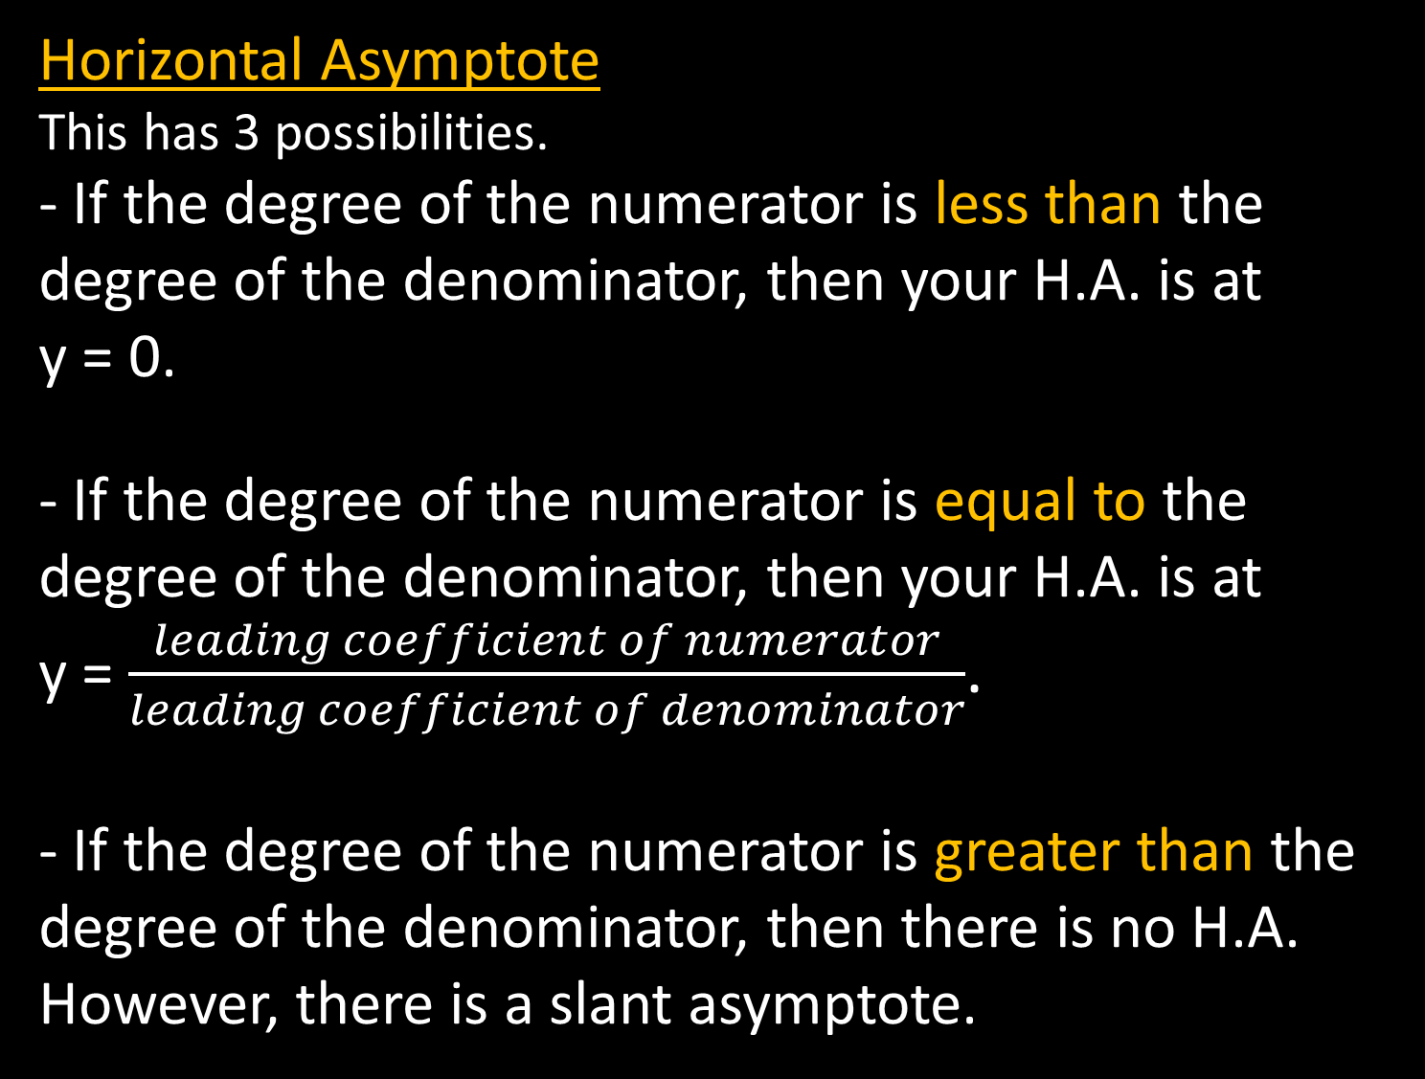
Horizontal Asymptote
This has 3 possibilities.
- If the degree of the numerator is less than the degree of the denominator, then your H.A. is at y = 0.
- If the degree of the numerator is equal to the degree of the denominator, then your H.A. is at y = $\frac{leading coefficient of numerator}{leading coefficient of denominator}$.
- If the degree of the numerator is greater than the degree of the denominator, then there is no H.A. However, there is a slant asymptote.
Examples…

Slide 17
Top 10 Things to Describe a Graph
Parent Function, Type/degree
Transformations
Domain/Range (in Interval Notation)
Continuity (continuous, point discontinuity at x= )
Extrema (are points: minimum, maximum)
Asymptotes (x= , and y= , and behavior with Limit Notation)
End Behavior (with Limit Notation)
Middle Behavior ($f\left(x\right)$ is increasing/decreasing on interval)
Zeroes, Multiplicity, y-intercept
Symmetry and Boundedness

