Slide 1
The Sky is the Limit! Or is it?
What is this “limit” business?
It’s all about motion! What is the function approaching?
Let’s investigate…
Four examples

Slide 2
The Sky is the Limit! Or is it?
If you approach the same y value, as you
approach x from the right, as you do when
you approach x from the left, the limit exists
at that y value! (whether a y value exists
there or not!)
What is the function approaching, not what does the function actually hit.

Slide 3
The Sky is the Limit! Or is it?
How do you evaluate (or find) the limit?
Use direct substitution
Remove the discontinuity
Rewrite the expression
Factor out the Point Discontinuity
Multiply by 1 to remove the Point Discontinuity
Vertical Asymptote
Visualize the graph!
Table of values!

Slide 4
The Sky is the Limit! Or is it?
Assuming that $\lim_{x→c}f(x)$ and $\lim_{x→c}g(x)$ exist…
Addition/Subtraction Rule
$$\lim_{x→c}\left(f\left(x\right)±g\left(x\right)\right)=\lim_{x→c}{f\left(x\right)±\lim_{x→c}{g\left(x\right)}}$$
Multiplication Rule
$$\lim_{x→c}\left(f\left(x\right)g(x)\right)=\lim_{x→c}{f(x)\lim_{x→c}{g(x)}}$$
Constant Rule
$$\lim_{x→c}\left(kg(x)\right)=\lim_{x→c}{k\lim_{x→c}{g(x)}}$$

Slide 5
The Sky is the Limit! Or is it?
Quotient Rule
$$\lim_{x→c}\frac{f(x)}{g(x)}{=}\frac{\lim_{x→c}{f(x)}}{\lim_{x→c}{g(x)}}$$
5) Power Rule
$$\lim_{x→c}{f(x)}^{n}{=}{\left(\lim_{x→c}{f(x)}\right)}^{n}$$
Root Rule
$$\lim_{x→c}\sqrt[n]{f(x)}{=}\sqrt[n]{\lim_{x→c}{f(x)}}$$

Slide 6
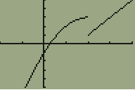
The Sky is the Limit! Or is it?
One Sided Limits: When a jump discontinuity (piecewise function) we approach different y values as we approach the same x.
The limit does not exist but we can still describe each side.
As x approaches c from the left only
$$\lim_{x→c^{−}}\left(f(x)\right)=$$
As x approaches c from the right only
$$\lim_{x→c^{+}}\left(f(x)\right)=$$

Slide 7
The Sky is the Limit! Or is it?
Infinity: Describes end behavior and vertical asymptotes.
$$\lim_{x→∞}\left(f(x)\right)=$$
as x approaches $∞$ what is $f(x)$ approaching?
End Behavior!
$$\lim_{x→−∞}\left(f(x)\right)=$$
as x approaches $−∞$ what is $f(x)$ approaching?
$$\lim_{x→c}\left(f(x)\right)=±∞$$
as x approaches $c$ $f(x)$ is approaching $±∞$
Vertical Asymptote!
$\lim_{x→±∞}\left(f(x)\right)=±∞$?
Notice WHERE $∞$ is!

Slide 8
The Sky is the Limit! Or is it?
$$\lim_{x→−∞}\left(f(x)\right)=0$$
$$f\left(−1\right)=0$$
$$f\left(1\right)=1$$
$$\lim_{x→∞}\left(f(x)\right)=3$$
$$f\left(0\right)=−2$$
$$\lim_{x→−2}\left(f(x)\right)=2$$
$$f\left(2\right)=4$$
$$\lim_{x→1^{−}}\left(f(x)\right)=−1$$
$$\lim_{x→1^{+}}\left(f(x)\right)=3$$

Slide 9
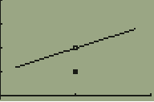
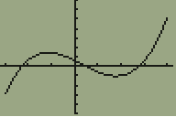
The Sky is the Limit! Or is it?
Continuity
Functions
Functions at a POINT
All Points in the interval
$$\lim_{x→c}\left(f\left(x\right)\right)=f(c)$$
Each Endpoint of the interval
$$\lim_{x→r^{−}}\left(f(x)\right)=f(r)$$
$$\lim_{x→l^{+}}\left(f(x)\right)=f(l)$$

Slide 10
Slide here about polynomials are continuous, rationals are ON THEIR DOMAIN and pretty much every other function we have looked at are continuous. Which ones aren’t continuous then? Piecewise functions
Decomposition proof of continuity

Slide 11
The Sky is the Limit! Or is it?
Functions at a POINT
A function f is continuous at c iff
$$\lim_{x→c}\left(f\left(x\right)\right)=f(c)$$
Requires 1. f must be defined at c 2. f must have a limit as x approaches c 3. the limit must equal f(c)

Slide 12
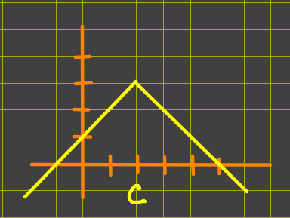
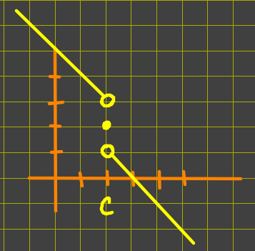
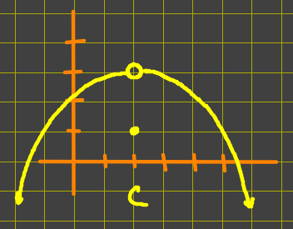
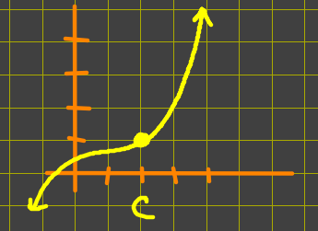
The Sky is the Limit! Or is it?

Slide 13
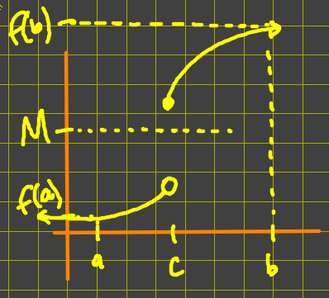
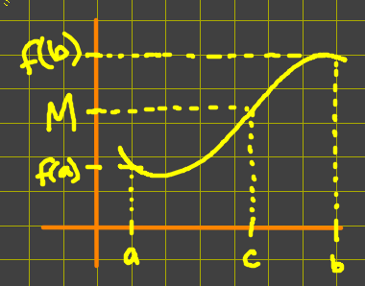
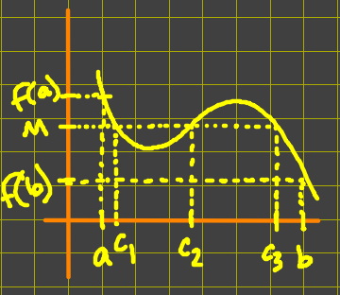
The Sky is the Limit! Or is it?
The Intermediate Value Theorem
If f(x) is continuous on [a,b] and f(a) $≤$ M $≤$ f(b), then at least one c exists in [a,b] so that f(c)=M.

Slide 14
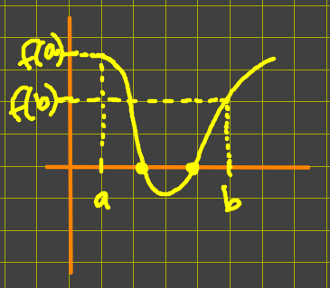
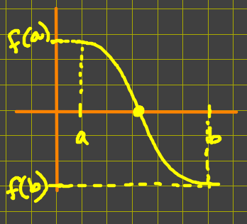
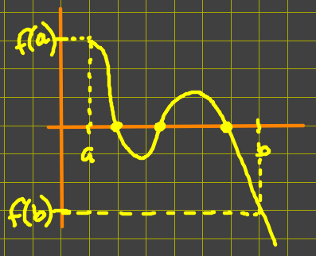
The Sky is the Limit! Or is it?
The Location Principal
If f(x) is continuous on [a,b] and f(a) and f(b) have opposite signs, then f(x) has at least one zero in [a,b].

Slide 15
Graphing Rational Functions
The Sky is the Limit! Or is it?
x-intercepts (zeroes) These occur at the real zeroes of the numerator (assuming they are NOT zeroes of the denominator)
y-intercept Let x = 0 and you’ll find your y.
Vertical Asymptotes These occur at the real zeroes of the denominator (assuming they are NOT zeroes of the numerator with equal or greater multiplicity, if this is the case we call them Point Discontinuities)

Slide 16
The Sky is the Limit! Or is it?
Horizontal Asymptote There are 3 possibilities.
- If the degree of the numerator is less than the degree of the denominator, then your H.A. is at y = 0.
- If the degree of the numerator is equal to the degree of the denominator, then your H.A. is at
y = $\frac{leading coefficient of numerator}{leading coefficient of the denominator}$.
- If the degree of the numerator is greater than the degree of the denominator, then there is no H.A. However, there is a slant or other type asymptote, found by the quotient of the division of the rational function.

