Slide 1
The Exponential and Logarithmic Functions
Tada!

Slide 2
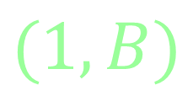
The Exponential Model
3.1a
The Parent Function:
$$f\left(x\right)=B^{x}$$
The Transformations:
$$f\left(x\right)={aB}^{b(x−h)}+k$$
The VIP’s:
Other stuff:
$$H.A. @ y=0$$
y$−int @ (0,1)$
$$(1,B)$$

Slide 4
The Exponential Model
3.1b
Why does it look like it does?
$$f\left(x\right)={\left(\frac{1}{3}\right)}^{x}$$
$$f\left(x\right)={2\left(\frac{1}{3}\right)}^{x}$$
$$f\left(x\right)=2^{x}$$
x | y
-2
-1
0
1
2
3
x | y
-2
-1
0
1
2
3
x | y
-2
-1
0
1
2
3

Slide 5
The Exponential Model
3.1b
Why does it look like it does?
x | y
-2 | $$\frac{4}{9}$$
-1 | $$\frac{4}{3}$$
0 | 4
1 | 12
2 | 36
3 | 108
x | y
-2 | 128
-1 | 32
0 | 8
1 | 2
2 | $$\frac{1}{2}$$
3 | $$\frac{1}{8}$$
$$f\left(x\right)={8\left(\frac{1}{4}\right)}^{x}$$
$$f\left(x\right)={4\left(3\right)}^{x}$$

Slide 6
3.1b
(doubled, cut in half, etc.)
Base as an obvious multiplier
$$f(x)=a{(base)}^{x}$$
$$a=initial value$$
$$(y−intercept when no h or k movement)$$
$$base=multiplier$$
$$(base)>1 → exponential growth$$
Assuming a is greater than 0
$$0<(base)<1 → exponential decay$$
Assuming a is greater than 0

Slide 7
3.1b
The Natural Base
Leonhard Euler
Andrew Jackson
$$e=2.71828182845904523$$
$$e=\lim_{x→∞}{{\left(1+\frac{1}{x}\right)}^{x}}$$
“e…is…a little less than 3”
$$\sqrt[w]{b^{v}}=b^{\frac{v}{w}}$$
The Logistic Function
$$a^{−n}=\frac{1}{a^{n}}$$
$$f(x)=\frac{1}{1+e^{−x}}$$

Slide 8
(Population, radioactive decay)
3.2a
(doubled, cut in half, etc.)
Base as a percentage rate
Base as an obvious multiplier
$$f(x)=a{(base)}^{x}$$
$$P(t)=P_{0}{(1+r)}^{t}$$
$$a=initial value$$
$$P_{0}=a=inital value$$
$$base=multiplier$$
$$r=percentage rate$$
Ex’s 1-4 in book pg. 265
$$t=time, usually years$$
$$but pay attention$$
$$(base)>1 → exponential growth ←(1+r)>1$$
$$0<(base)<1 → exponential decay ←0<(1−r)<1$$

Slide 9
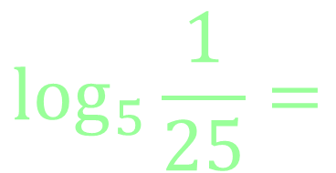
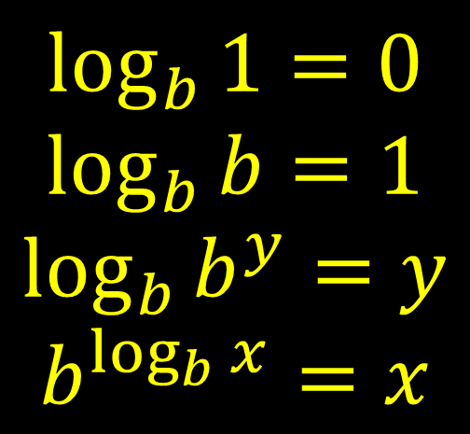
The Logarithmic Model
3.3a
What is it?
A logarithm IS the exponent!
$\log_{b}{x=y}$ is equivalent to ${x=b}^{y}$
$$\log_{2}{8}=$$
$$\log_{6}{36}=$$
Some Properties
$$\log_{3}{\sqrt{3}}=$$
$$\log_{b}{1=0}$$
$$\log_{b}{b=1}$$
$$\log_{b}{b^{y}=y}$$
$$b^{\log_{b}{x}}=x$$
$$\log_{5}{\frac{1}{25}}=$$
$$\sqrt[w]{b^{v}}=b^{\frac{v}{w}}$$
$$\log_{4}{1}=$$
$$a^{−n}=\frac{1}{a^{n}}$$
$$\log_{7}{7}=$$

Slide 10
3.3a
The Common Log
$$\log_{10}{x}=\log{x}$$
Base is 10
The Natural Log
$$\log_{e}{x}=\ln{x}$$
“e…is…a little less than 3”
Base is e

Slide 11
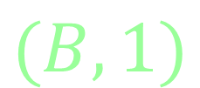
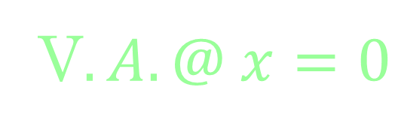
The Logarithmic Model
3.3b
The Parent Function:
$$f\left(x\right)=\log_{B}{x}$$
The Transformations:
$$f\left(x\right)={alog}_{B}{(b\left(x−h\right))}+k$$
The VIP’s:
Other stuff:
V$.A. @ x=0$
$$x−int @ (1,0)$$
$$(B,1)$$

Slide 14
Properties of Logarithms
3.4a
$$\log_{b}{mn}=\log_{b}{m}+\log_{b}{n}$$
$$\log_{b}{\frac{m}{n}}=\log_{b}{m}−\log_{b}{n}$$
$$\log_{b}{m^{c}}=c\log_{b}{m}$$
$$\sqrt[w]{b^{v}}=b^{\frac{v}{w}}$$
$$\log_{b}{1=0}$$
$$\log_{b}{b=1}$$
$$\log_{b}{b^{y}=y}$$
$$b^{\log_{b}{x}}=x$$
$$a^{−n}=\frac{1}{a^{n}}$$

Slide 15
Solving Logarithms or for variables in the exponent
3.5a
Make the bases the same (sometimes works)
$$b^{y}=b^{y} \\ \log_{b}{x}=\log_{b}{x}$$
Rewrite (works nearly all of the time) $\log_{b}{x=y}$ is equivalent to ${x=b}^{y}$
Take the log of both sides (always works)

Slide 16
Graphing Logarithms/Exponents
Exponential
Logarithmic
$$f(x)=ab^{x−h}+k$$
$$y=a\log_{b}{(x−h)}+k$$
$$f(x)=ab^{x}$$
$$P(t)=a{(1+r)}^{t}$$
$$a=initial value r=\% \\ b=growth rate \\ b>1 exponential growth →b=(1+r) \\ 0<b<1 exponential decay →b=(1−r)$$
Simplifying and Solving
Make the bases the same (sometimes works)
$$b^{y}=b^{y} \\ \log_{b}{x}=\log_{b}{x}$$
Rewrite (always works) $\log_{b}{x=y}$ is equivalent to ${x=b}^{y}$

