Slide 1
Sequence: an ordered progression of numbers
Two types that we will study:
1. Arithmetic – common difference (linear)
2. Geometric – common ratio (exponential)
Explicit – term value ($a_{n}$) determined by what term it is ($n$)
Recursive – term value ($a_{n}$) determined by the previous term $\left(a_{n−1}\right)$ and the starting point

Slide 2
First Term Value | Second Term Value | Third Term Value | Fourth Term Value | nth term Value
$$a_{1}$$ | $$a_{2}$$ | $$a_{3}$$ | $$a_{4}$$ | $$a_{n}$$
$$n$$ | 1 | 2 | 3 | 4 | 5 | $$n$$
$$a_{n}$$ | 1, | 8, | 15, | 22, | 29, | ... $a_{n}$
$a_{1}$=1, | $a_{2}=$8, | $a_{3}=$15, | $a_{4}=$22, | $a_{5}=$29, | $$a_{n}=7n−6$$

Slide 3
Sequences | Arithmetic (linear) | Geometric (exponential)
Recursive (recursion) Defined by previous value | $$Next=Now+m$$ $$starting @ a_{0}$$ $$a_{n}=a_{n−1}+m$$ $$starting @ a_{1}$$ | $$Next=Now(r)$$ $$starting @ a_{0}$$ $$a_{n}=a_{n−1}r$$ $$starting @ a_{1}$$
Explicit (explication) Defined by term number | $$a_{n}=mn+a_{0}$$ $$a_{n}=m(n−1)+a_{1}$$ | $$a_{n}=a_{0}r^{n}$$ $$a_{n}=a_{1}r^{n−1}$$
ME
ME
BOOK
BOOK
ME
ME
BOOK
BOOK
Converge – a sequence that approaches a value
Diverge – a sequence that approaches $∞ or −∞$

Slide 4
Series: a sequence added together
Last term to be added
$$\sum_{k=1}^{n}{a_{k}}=a_{1}+a_{2}+a_{3}+…+a_{n}$$
First term to be added
Explicit Rule
Arithmetic
Geometric
$$\sum_{k=1}^{n}{a_{n}}=\frac{n(a_{1}+a_{n})}{2}$$
$$\sum_{k=1}^{n}{a_{n}}=\frac{a_{1}(1−r^{n})}{1−r}$$

Slide 5
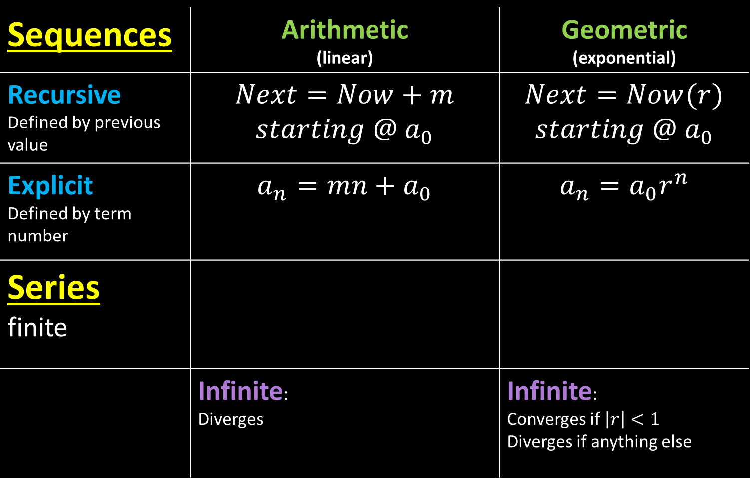
Sequences | Arithmetic (linear) | Geometric (exponential)
Recursive Defined by previous value | $$Next=Now+m$$ $$starting @{ a}_{0}$$ | $$Next=Now(r)$$ $$starting @{ a}_{0}$$
Explicit Defined by term number | $$a_{n}=mn+a_{0}$$ | $$a_{n}=a_{0}r^{n}$$
Series finite
 | Infinite: Diverges | Infinite: Converges if $\left|r\right|<1$ Diverges if anything else
$$\sum_{k=1}^{n}{a_{n}}=\frac{n(a_{1}+a_{n})}{2}$$
$$\sum_{k=1}^{n}{a_{n}}=\frac{a_{1}(1−r^{n})}{1−r}$$

