Slide 1
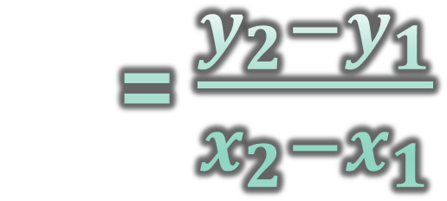
Writing Equations of Lines
1. Slope
2. Point
Slope
= $\frac{RISE}{RUN}$
= $\frac{∆y}{∆X}$
= $\frac{y_{2}−y_{1}}{x_{2}−x_{1}}$
Point Slope Form
$y−y_{1}=m(x−x_{1})$

Slide 2
Writing Equations of Lines
Slope Intercept Form
$$y=mx+b$$
Standard Form
$$Ax+By+C=0$$

Slide 3
Parallel Lines
“never touch”
Two lines in the same plane that have the SAME SLOPE.

Slide 4
Perpendicular Lines
“90 degrees”
Two lines in the same plane that have OPPOSITE RECIPROCAL SLOPES.

Slide 5
#2 Factoring
#1 Square Root Method
- When it works, it’s fast (Either no linear term or quantity squared)
- Part of completing the square
- Standard Form→Factoring →Factored Form
- Zero Product Property: If $ab=0, then a=0$ $or b=0$
#3 The Quadratic Formula
- Works every time! And it skips right to x-intercepts (zeroes/solutions)
- If $ax^{2}+bx+c=0, then$
$$x=\frac{−b±\sqrt{b^{2}−4ac}}{2a}$$

Slide 6
Standard Form
Rational Zero Theorem Long Division, Synthetic Division, Factoring
Factored Form
Quadratic Formula, Square Root Method, Calculator
Factors
Zero Product Property
Zeroes

