Slide 1
Expressions
- No relationship, No equality or inequality
- Simplify and evaluate
  5 things You can do to Simplify an Expression
    Expand it! (Factoring)
    Condense it! (Distribute and combine like terms and simplify exponents)
    Multiply by 1 (in terms of the conjugate)
    Simplify complex fractions
    Get a common denominator
- Order of operations for Simplifying
- PEMDAS (which really should be GEMDAS)

Slide 2

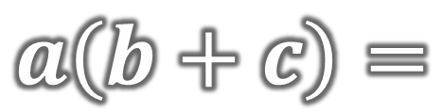

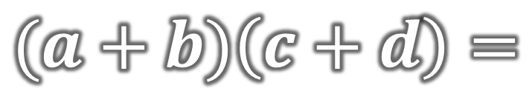
Distributive Property
$$a\left(b+c\right)=$$
$$ab+ac$$
Multiplication involving quantities with addition/subtraction
$$(a+b)\left(c+d\right)=$$
$$ac+ad+bc+bd$$

Slide 3
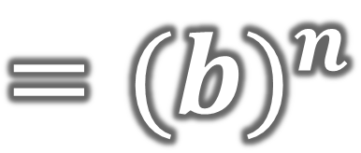
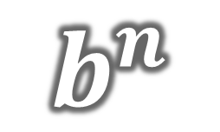
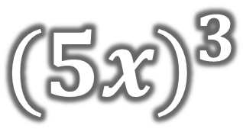
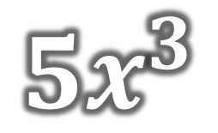
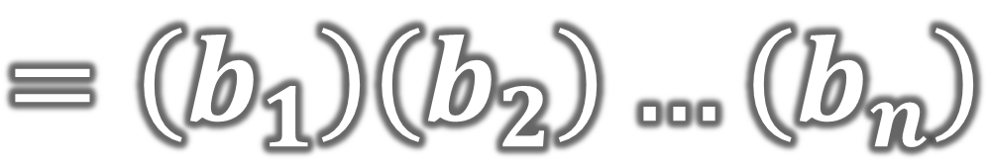
Exponents
Power/Exponent
$$b^{n}$$
$$=\left(b_{1}\right)\left(b_{2}\right)…\left(b_{n}\right)$$
$$=({b)}^{n}$$
Base
n factors of b
$${5x}^{3}$$
$${(5x)}^{3}$$

Slide 4
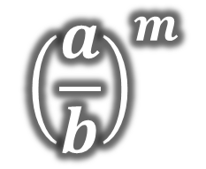
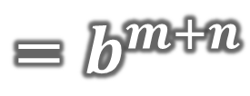
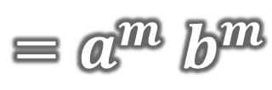
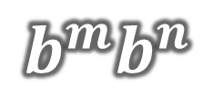
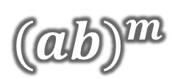
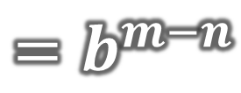
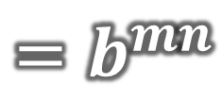
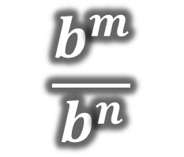
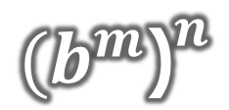
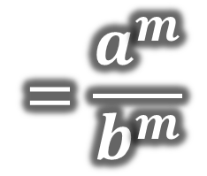
Exponent Properties
$$b^{m}b^{n}$$
$$=b^{m+n}$$
“multiplying like bases”
$${{(b}^{m}\text{)}}^{n}$$
$${=b}^{mn}$$
“power raised to a power”
$${(ab)}^{m}$$
$${=a}^{m}b^{m}$$
“power of a product”
$${\left(\frac{a}{b}\right)}^{m}$$
$$=\frac{a^{m}}{b^{m}}$$
“power of a quotient”
$$\frac{b^{m}}{b^{n}}$$
$$=b^{m−n}$$
“dividing like bases”

Slide 5
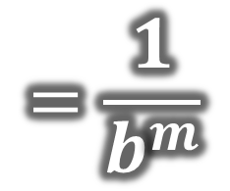
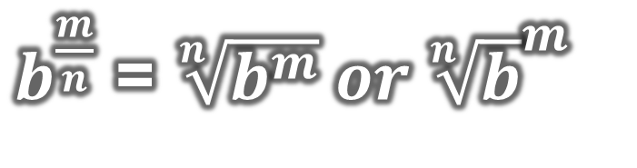
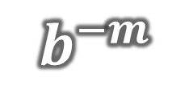
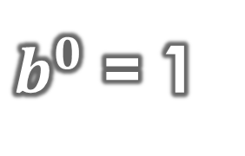
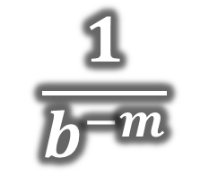
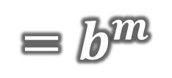
Exponent Properties
$$=\frac{1}{b^{m}}$$
$$b^{−m}$$
“negative exponent means reciprocate”
$$\frac{1}{b^{−m}}$$
$${=b}^{m}$$
$b^{0}$ = 1
$b^{\frac{m}{n}}$ = $\sqrt[n]{b^{m}} or {\sqrt[n]{b}}^{m}$

Slide 6
Simplifying Exponents
No negative exponents
No values of 1 (reduce fractions completely)
No parentheses

Slide 7





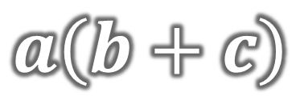


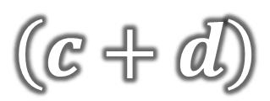
Factoring
Process of breaking a product down into its factors
Inverse operation of distribution
$$a\left(b+c\right)=$$
$$ab+ac$$
$$ab+ac=$$
$$a\left(b+c\right)$$
$$(a+b)\left(c+d\right)=$$
$$ac+ad+bc+bd$$
$$(a$$
$$+ b)$$
$$\left(c+d\right)$$

Slide 8
Expressions
- No relationship, No equality or inequality
- Simplify and evaluate
  5 things You can do to Simplify an Expression
    Expand it! (Factoring)
    Condense it! (Distribute and combine like terms and simplify exponents)
    Multiply by 1 (in terms of the conjugate)
    Simplify complex fractions
    Get a common denominator
- Order of operations for Simplifying
- PEMDAS (which really should be GEMDAS)

Slide 9

Equations =
Equations/Inequalities
- A relationship between two expressions
- We will still simplify the expressions on each side of equals sign
- We will also solve the equation/inequality using inverse operations across the equal sign
- Order of operations for Solving; SADMEP
Inequalities $<,≤,≥,>$
- Answers are finite!
Answers are infinite!
Interval Notation

