Slide 1
Polynomial Functions!
Many Terms

Slide 2
Symbolic Definition
$f\left(x\right)=a_{n}x^{n}+a_{n−1}x^{n−1}+∙∙∙+a_{2}x^{2}$+$a_{1}x$+$a_{0}$
Standard Form
Exponents are in descending order
Exponents are positive integers
$n$ = degree of polynomial
$a_{n}$ = leading coefficient

Slide 3
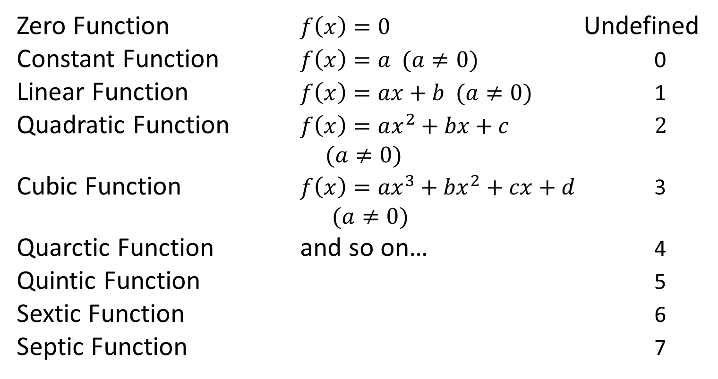
Labeling Polynomial Functions
Name Form Degree
Zero Function $f\left(x\right)=0$ Undefined
Constant Function $f\left(x\right)=a (a≠0)$ 0
Linear Function $f\left(x\right)=ax+b (a≠0)$ 1
Quadratic Function $f\left(x\right)=ax^{2}+bx+c$ 2
$$(a≠0)$$
Cubic Function $f\left(x\right)={ax}^{3}+{bx}^{2}+cx+d$ 3
$(a≠0)$
Quarctic Function and so on… 4
Quintic Function 5
Sextic Function 6
Septic Function 7

Slide 4
Notation
$$y=f(x)$$
input
output
$$f\left(x\right)=x^{2}+5x−7$$
$$f\left(input\right)={(input)}^{2}+5(input)−7$$
$$output={(input)}^{2}+5(input)−7$$
$$f(input)=output$$
$$f(x)=y$$
$$f\left(2\right)=3$$
$$f\left(−1\right)=4$$
$$slope$$

Slide 5
Vertex (Transformation) Form
$$f\left(x\right)=a{\left(x−h\right)}^{2}+k$$
Look familiar?
$a$ = vertical stretch/shrink thing (factor)
$h$ = horizontal shift
$k$ = vertical shift
$(h,k)$ = where the vertex is!
$x=h$ line of symmetry
$x−intercepts$ use the square root method!

Slide 6
Standard Form
$$f\left(x\right)=ax^{2}+bx+c$$
$a$ = vertical stretch/shrink thing (factor)
$\frac{−b}{2a}$ = horizontal shift (x value of vertex)
$f(\frac{−b}{2a}$) = vertical shift (y value of vertex)
$(\frac{−b}{2a},f(\frac{−b}{2a}\text{)})$ = where the vertex is!
$x=\frac{−b}{2a}$ line of symmetry
$x−intercepts$ = factor or quadratic formula

Slide 7
Intercept (Factored) Form
$$f\left(x\right)=a(x−p)(x−q)$$
$a$ = vertical stretch/shrink thing (factor)
$p and q$ = x-intercepts
$\frac{p+q}{2}$ = x value of vertex
$f(\frac{p+q}{2}$) = y value of vertex
$x=\frac{p+q}{2}$ line of symmetry
$x−intercepts$ set each factor equal to zero

Slide 8
Translate between the Forms
Vertex Standard Intercept
distribute and combine like terms
Vertex Standard Intercept
Complete the square!
Factor!

Slide 9
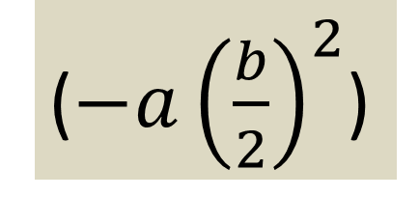
Completing the Square
0.
0. Factor out the leading coefficient
1. Take half the middle ($b$) term =$\left(\frac{b}{2}\right)$
2. Square that value (${\left(\frac{b}{2}\right)}^{2}$)
3. Add it to the expression ($+{\left(\frac{b}{2}\right)}^{2}$)
3.5.
3.5. Distribute
4. Subtract it from the expression ($−{\left(\frac{b}{2}\right)}^{2}$)
($−a{\left(\frac{b}{2}\right)}^{2}$)
5. Factor the perfect square ${\text{(}\text{x}\text{+}\left(\frac{b}{2}\right)\text{)}}^{2}$

